Slide 1

Lists and Arrays

Slide 2
List
Ordered or sequenced collection of objects
A way to move around many values together
Elements can be accessed in the list via an index
Index is an integer that starts at 0
Lists can contain duplicate entries
A wrapper around an Array

Slide 3
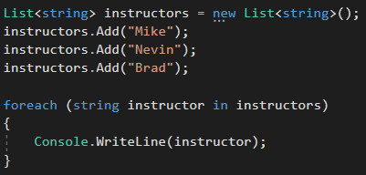

List Example
Output:

Slide 4
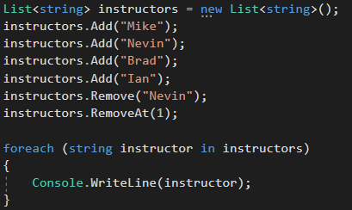

List Example
Output:

Slide 5
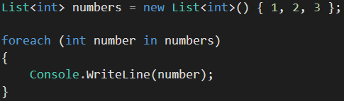
List
A way to create the list size and add values at the same time:

Slide 6
List
Lists don’t have to be of just data type string, int, boolean, etc.
In Object-Oriented Programming, it may be more useful to have a list of a user-defined class or object

Slide 7
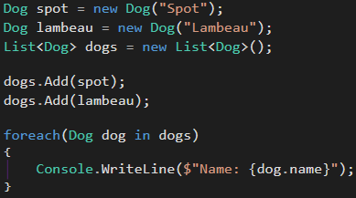

List Example
For example, there is a class Dog:
Output:

Slide 8
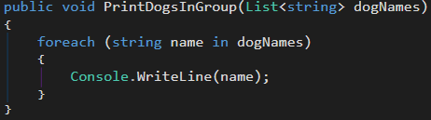
List Example
List can be passed as an argument to another method

Slide 9
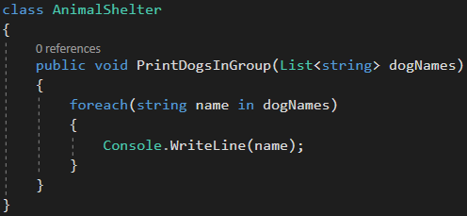
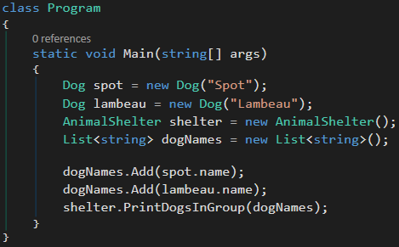
List
Now we can call the method in the Program class and pass the List as an argument

Slide 10
Array
Arrays store a fixed-size collection of elements of the same data type
In order to use an array, you must declare a variable to reference the array:
In the above example, packersArray will reference the string array

Slide 11
Array
One of the main differences between an array and a list is you must declare the size of the array on creation.
To initialize an array, you must use the new keyword to create an instance of the array in memory:
In the above example, packersArray holds five values, with indices from 0 to 4.

Slide 12
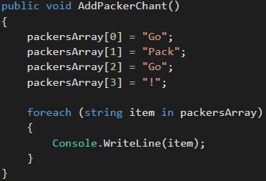
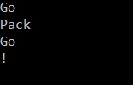
Array
To add values to packersArray:
Output:
* Notice the blank space after the ‘!’. This shows that the fifth index, or [4], in the array is null.

Slide 13
Array
A way to create the array size and add values at the same time:
instructorArray has an array size of 4, with string values “Hello” at index 0, “I’m” at index 1, “an” at index 2, and “instructor” at index 3;

Slide 14
Review Questions
What is a List? Give an example of why you should use one?
What is an array? Give an example of why you should use one?
What is the difference between a List and an Array?
When should you use an Array over a List?

